Slide 1

Azure and DevOps
Azure Kubernetes Service. Azure DevOps Services
SoftUni Team
Technical Trainers
Software University
https://softuni.org

Slide 2
Have a Questions?
sli.do
#azure-essentials
facebook.com
/groups/AzureEssentialsFebruary2022

Slide 3
Homework Progress
Solutions for M3
can be submitted
until 23:59 on 27.03.2022
Solutions for M4
can be submitted
until 23:59 on 30.03.2022
Solutions for M5
can be submitted
until 23:59 on 06.04.2022

Slide 4

Previous Module (M4)
Quick Overview

Slide 5
What We Covered
Containers in Azure
Azure App Services
Azure Functions
Azure Logic Apps

Slide 6
This Module (M5)
Topics

Slide 7
Table of Contents
Azure Kubernetes Service
Azure DevOps Services
Boards
Repos
Pipelines
DevOps Projects

Slide 8
The End is Near ☺
THIS MODULE
ONE
GO
MORE
AND
TO

Slide 9
Exam Blueprint
Exam Blueprint could be found
in the Resource Section of the Course

Slide 10
Prepare for the Test (Practice Questions)
Test Your Knowledge
https://zahariev.pro/q/aze
Will be available after 10:00:00 on 28.03.2022

Slide 11
Azure Kubernetes Service
Introduction to Kubernetes and AKS

Slide 12
Container Orchestration
Workload deployment and distribution
Resource governance
Scalability and availability
Automatization and management
Internal and external communication

Slide 13
What Kubernetes Does?
Run a cluster of hosts
Schedule containers to run on different hosts
Facilitate the communication between the containers
Provide and control access to/from outside world
Track and optimize the resource usage

Slide 14
Architecture Overview
Kubernetes Cluster
Master Node
Master Node
Node 1
Node 2
Master Node
Pod 1
Pod 1
Proxy
Proxy
Scheduler
Kubelet
Pod n
Kubelet
Pod n
Managed by Azure
(this is free)
Our responsibility
(we pay for this)
Controller
Node 3
Node 4
API Server
Pod 1
Pod 1
Proxy
Proxy
Key-Value Store
Kubelet
Pod n
Kubelet
Pod n

Slide 15
Masters
Responsible for managing the cluster
Typically, more than one is installed
In HA mode one Master node is the Leader
It is work-free
Components running on master are also known as Control Plane
Can be reached via CLI (kubectl), APIs, or Dashboard
Master Node
Scheduler
Controller
API Server
Key-Value Store

Slide 16
(Worker) Nodes
Initially called Minions
Container runtime
containerd, rkt, lxd
Kubelet
Communicates with master
Uses CRI shims
kube-proxy
Network proxy
Node 1
Proxy
Kubelet
Container Runtime
Pod 1
Pod 2

Slide 17
Pods (1)
Smallest unit of scheduling
One or more containers
Containers share the pod environment
Scheduled on nodes
It is atomic – deployed as one and on one node
Created via manifest files
Pod
Environment
net
mount
Main container
Supporting containers

Slide 18
Pods (2)
Pod 1
Pod 2
localhost
localhost
10.10.20.20
10.10.20.21
Pod Network
Each pod has unique IP address
Inter-pod communication is via a pod network
Intra-pod communication is via localhost and port

Slide 19
Replication Controllers
Higher level workload
Looks after pod or set of pods
Scale up/down pods
Sets Desired State
Replication Controller
Pod

Slide 20
Deployments
Even higher-level workload
Simplifies updates and rollbacks
Declarative and imperative approach
Self documenting
Suitable for versioning
Deployment
Replication Set
Pod

Slide 21
Services
Provide reliable network endpoint
IP address
DNS name
Port
Expose Pods to the outside world
NodePort (cluster-wide port)
LoadBalancer (cloud-based)
Use End Point object to track Pods
Pod A IP, Pod B IP, …
IP: 10.10.10.1
DNS: demo-svc
Port: 32001
End Point
Service
Node 1
Node 2
Pod A
Pod B
10.10.20.21
10.10.20.22

Slide 22
Services in Action
Services user label selectors to do their magic
Service
app = myapp
version = v01
Pod
Pod
app = myapp
app = myapp
version = v01
version = v01
Initial deployment – two pods with version = v01

Slide 23
Services in Action
Services user label selectors to do their magic
Service
app = myapp
version = v01
Pod
Pod
Pod
Pod
app = myapp
app = myapp
app = myapp
app = myapp
version = v01
version = v02
version = v02
version = v01
Next step – add two more pods with version = v02

Slide 24
Services in Action
Services user label selectors to do their magic
Service
app = myapp
version = v02
Pod
Pod
Pod
Pod
app = myapp
app = myapp
app = myapp
app = myapp
version = v01
version = v02
version = v02
version = v01
Next step – we update the service to look for version = v02

Slide 25
Services in Action
Services user label selectors to do their magic
Service
app = myapp
version = v02
Pod
Pod
app = myapp
app = myapp
version = v02
version = v02
Finally, all pods with version = v01 are destroyed

Slide 26
Azure Kubernetes Service (AKS)
Ship faster, operate with ease, and scale confidently
Accelerate containerized application development
Manage Kubernetes with ease
Build on an enterprise-grade, more secure foundation
Run any workload in the cloud, at the edge, or as a hybrid
https://azure.microsoft.com/en-us/services/kubernetes-service/

Slide 27
Practice: Azure Kubernetes Services
AKS in Action

Slide 28
DevOps
Methodologies. Practices. Continuous (Something)

Slide 29
What is DevOps?
PEOPLE,
CONTINUOUS
DELIVERY
THE
UNION OF
PROCESS,
TO ENABLE
OF VALUE TO
OUR END USERS
AND PRODUCTS
https://docs.microsoft.com/en-us/azure/devops/learn/what-is-devops

Slide 30
The Road to DevOps (1)
Understand your Cycle Time
Observe, Orient, Decide, Act
Become Data-Informed
Use data to inform what to do in your next cycle
Strive for Validated Learning
Feedback gathered with each cycle should be real, actionable data

Slide 31
The Road to DevOps (2)
Shorten your Cycle Time
Smaller batches, more automation, improved telemetry, frequent deployments
Optimize Validated Learning
The sum of improvements that you achieve and the failures that you avoid

Slide 32
How to Achieve DevOps?
Containers
Infrastructure as Code
Microservices
Lean Project Management
Monitoring and
Logging
Public and
Hybrid Clouds
Continuous
Integration
Continuous
Delivery
Version Control
Agile Planning

Slide 33
Continuous (Something)
Continuous Integration
Series of steps that are automatically performed to integrate code from multiple sources, create a build and test
Continuous Delivery
Helps you build a refined version of the software by continuously implementing fixes and feedback until finally, you decide to push it out to production
Continuous Deployment
Every change goes through an automated pipeline and a working version of the application is automatically pushed to production
https://blog.codeship.com/whats-the-difference-between-continuous-delivery-vs-continuous-deployment/

Slide 34
CD vs CD
Continuous Delivery
Software can be released to production at any time
Every change can go to production
I could be deploying constantly
Continuous Deployment
Software is released to production as part of an automated pipeline
Every change goes to production
I am deploying constantly

Slide 35
Azure DevOps
Introduction

Slide 36
Two Offerings
Azure DevOps Services
CLOUD SERVICE
Azure DevOps Server
ON-PREMISES SERVER
https://azure.microsoft.com/en-us/pricing/details/devops/server/

Slide 37
Azure DevOps Services
Azure Boards (Agile planning tools)
Azure Pipelines (CI/CD for any platform and language)
Azure Repos (Unlimited free private repos)
Azure Test Plans (Manual and exploratory testing)
Azure Artifacts (Universal package repository)
Extensions Marketplace (Over 1000 extensions)
https://azure.microsoft.com/en-us/services/devops/

Slide 38
Azure DevOps Pricing (1)
Individual Services
Azure Pipelines
Azure Artifacts
User Licenses
Basic Plan (w/o Test Plans)
Basic + Test Plans
https://azure.microsoft.com/en-us/pricing/details/devops/azure-devops-services/

Slide 39
Azure DevOps Pricing (2)
Azure DevOps for Open Source
Azure Pipelines
Azure DevOps (all five products)
Included with Visual Studio Subscriptions
https://azure.microsoft.com/en-us/pricing/details/devops/azure-devops-services/

Slide 40
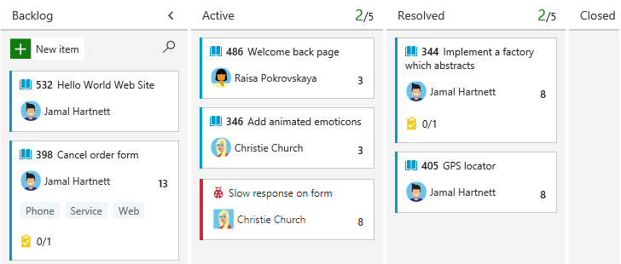
Azure Boards (1)
Provides a rich set of capabilities for managing software projects
The process defines the building blocks of a work-tracking system
Supports
Basic
Agile
Scrum
CMMI
https://docs.microsoft.com/en-us/azure/devops/boards/get-started/what-is-azure-boards

Slide 41
Azure Boards (2)
Work item types for Basic process are:
Epics are used to track significant features or requirements
Issues are used to track user stories, bugs, or other smaller items of work
Tasks are for even smaller amounts of work, measured in hours or days
Basic process uses the To Do, Doing, and Done states to track workflow status
Track work on interactive backlogs and boards
https://docs.microsoft.com/en-us/azure/devops/boards/get-started/what-is-azure-boards

Slide 42
Azure Boards (2)
Collaborate with others through the Discussion section
Work in sprints, plan and forecast
Work effectively by using hierarchies, queries, templates, etc.
Link issues and tasks to GitHub commits and pull requests
Support independent and autonomous teams
Can track work across several projects
https://docs.microsoft.com/en-us/azure/devops/boards/get-started/what-is-azure-boards

Slide 43
Azure Boards Tools (1)
Work items
Quickly find work items that are assigned to you
Boards
Present work items as cards and support drag-and-drop status updates
Backlogs
Present work items as lists. Represents your project plan
It is a sort of repository
https://docs.microsoft.com/en-us/azure/devops/boards/get-started/what-is-azure-boards

Slide 44
Azure Boards Tools (2)
Sprints
Sprint backlogs and task boards provide a view of work items by iteration or sprint
Queries
Filtered lists of work items based on criteria defined by us
https://docs.microsoft.com/en-us/azure/devops/boards/get-started/what-is-azure-boards

Slide 45
Azure Pipelines
Automatically build and test your code project
Combines continuous integration (CI) & continuous delivery (CD)
Supports Python, Java, JavaScript, PHP, Ruby, C#, C++, and Go
Integrates with GitHub, GitHub Enterprise, Azure Repos Git & TFVC, Bitbucket Cloud, and Subversion
Supports application types, such as Java, JavaScript, Node.js, Python, .NET, C++, Go, PHP, and Xcode
Multiple targets and package formats
https://docs.microsoft.com/en-us/azure/devops/pipelines/get-started/what-is-azure-pipelines

Slide 46
Azure Repos
A set of version control tools that you can use to manage your code
Supports distributed (Git) and centralized (TFVC) version control
Git in Azure Repos is standard Git
Connect your favorite development environment
Review code with pull requests
Protect branches with policies
Extend pull request workflows with pull request status
Isolate code with forks
https://docs.microsoft.com/en-us/azure/devops/repos/get-started/what-is-repos

Slide 47
Practice: Azure DevOps
Azure DevOps in Action

Slide 48
Azure DevOps Projects
Introduction

Slide 49
Azure DevOps Projects
Build any Azure application,
on any Azure service,
in less than five minutes
https://azure.microsoft.com/en-us/features/devops-projects/

Slide 50
Features
Built-in support for popular application frameworks
.NET, Java, PHP, Node, Python, Go and others
Deploy to the platform of your choice
Azure Web App, Virtual Machine, Service Fabric or choose AKS
Cloud-powered CI/CD
Auto-generated and fully integrated Azure Pipelines
Application Insights integration
Rich performance monitoring, powerful alerting, and dashboards
https://azure.microsoft.com/en-us/features/devops-projects/

Slide 51
Benefits Using DevOps Projects
Quickly deploy your application to Azure
Automate the setup of a CI/CD pipeline
View and understand how to properly set up a CI/CD pipeline
Further customize the release pipelines based on your specific scenarios
https://docs.microsoft.com/en-us/azure/devops-project/overview

Slide 52
Integration with Azure DevOps
DevOps Projects is powered by Azure DevOps
DevOps Projects automates all the work that's needed in Azure Pipelines to set up a CI/CD pipeline
Creates a Git repository in a new or existing Azure DevOps organization
Commits a sample application or your existing code to a new Git repository
https://docs.microsoft.com/en-us/azure/devops-project/overview

Slide 53
Integration with Azure DevOps
Establishes a CI trigger for the build so that every new code commit initiates a build
Creates a CD trigger and deploys every new successful build to the Azure service of your choice
The build and release pipelines can be customized further
https://docs.microsoft.com/en-us/azure/devops-project/overview

Slide 54
Practice: DevOps Projects
DevOps Projects in Action

Slide 55

Summary
Kubernetes (k8s) is a container orchestration solution
K8s has master nodes and (worker) nodes
Azure Kubernetes Service (AKS) is the managed service to run k8s clusters in Azure
DevOps is the union of people, process, and products to enable continuous delivery of value to our end users
Azure DevOps is a complete suite of services that covers the typical needs of a DevOps initiative
It is offered both as cloud service and on-premise
Azure DevOps Projects makes it easy to get started on Azure

Slide 56
Questions?
Notes:
56

Slide 57

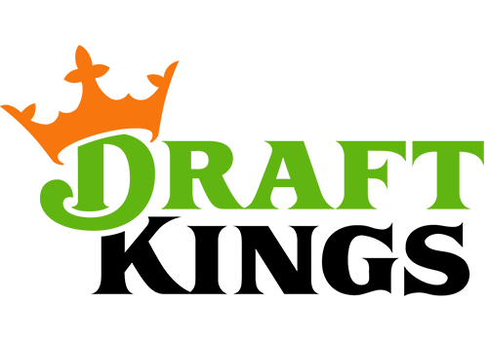
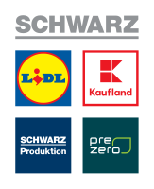

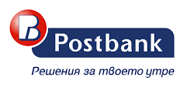


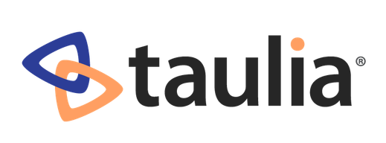
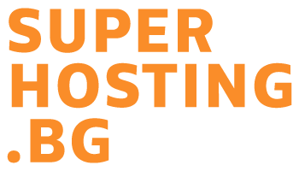

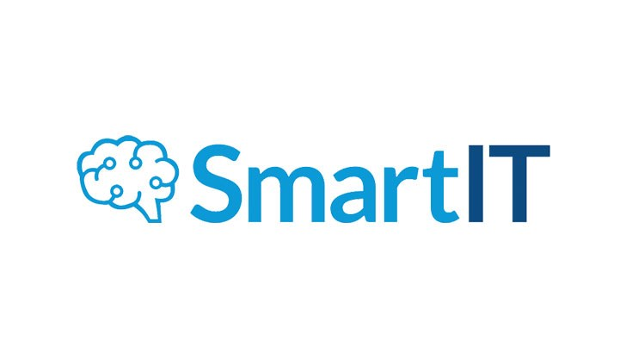

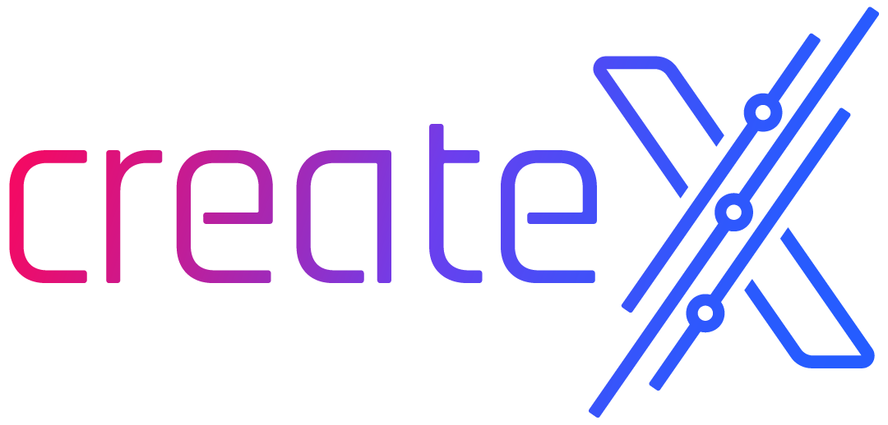
SoftUni Diamond Partners

Slide 58

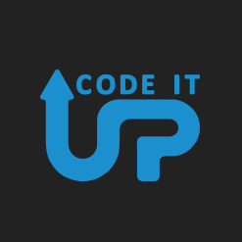
Educational Partners

Slide 59

License
This course (slides, examples, demos, exercises, homework, documents, videos and other assets) is copyrighted content
Unauthorized copy, reproduction or use is illegal
© SoftUni – https://softuni.org
© Software University – https://softuni.bg
Notes:
59

Slide 60
Trainings @ Software University (SoftUni)
Software University – High-Quality Education, Profession and Job for Software Developers
softuni.bg, softuni.org
Software University Foundation
softuni.foundation
Software University @ Facebook
facebook.com/SoftwareUniversity
Software University Forums
forum.softuni.bg
Notes:
60

